Slide 1

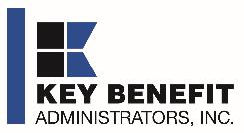

DIRECT-TO-EMPLOYER PLAN
September 11, 2024

Slide 2



Founded in 1979 and headquartered in Indianapolis, IN​
Full-service TPA specializing in the administration of self-funded health plans and population health management​
One of the country’s largest independently-owned TPAs
The Key Family is a commonly-held group of benefits related organizations with:​
3,000+ corporate clients​
3.0 million members under management​
700 Employees
Exclusive Relationships
We know The Market – Agents, Networks, and MGAs

Slide 3


Market Leader in Private-Labeled Plans
Louisville, KY
OneHealth Plan
Cincinnati, OH
TCH Optimal
Bentonville, AR
Northwest Health Plan
Knoxville, TN
East Tennessee Health Plan
Meridian, MS
Affinity Health Plan
Fort Myers, FL
Lee Health Care Partners

Slide 4

Key Incentive Plan (KIP) Profit Generation Opportunities for Just Health
1
2
Patient Steerage
Covered members of the Key Incentive Plan are more likely to seek services with Just Health than they would be in a standard PPO plan because they receive indemnity benefits and the financing credit card.
These incentives increase Just Health’s commercial market share and commercial profit within this plan.
Increased Margin
Because of the partnership between Key Benefits, and because patients have a financing path for medical costs, Just Health can expect higher realized revenue per patient from members of the Key Incentive Plan.
This partnership increases Just Health’s realized revenue per patient and lowers collection costs.

Slide 5
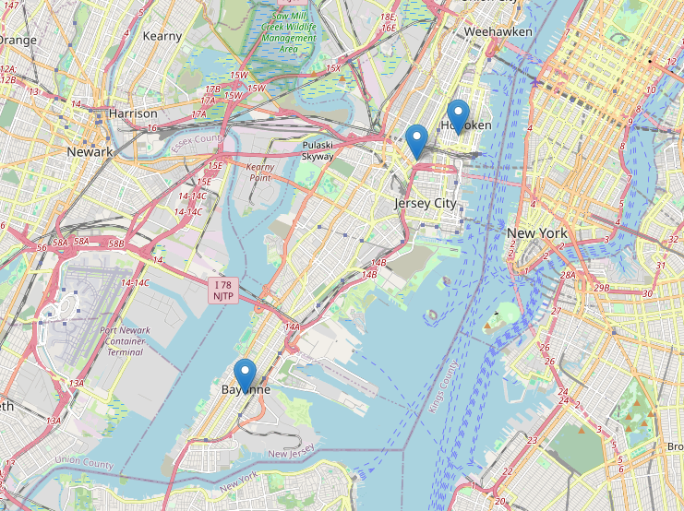
Significant Opportunity for Plan Growth Researched for Union, Essex and Hudson Counties
Target Market 2,500+ Employers 410,000+ Employees 630,000+ Members
 | Employer Size Group (# of Employees)
 | 50-100 | 101-200 | 201-400 | 401-1,000 | 1,001-3,000 | 3,000+
Commercial Employers Headquartered in Union, Essex or Hudson Counties | 1,468 | 597 | 417 | 230 | 64 | 54
 | 50-100 | 101-200 | 201-400 | 401-1,000 | 1,001-3,000 | 3,000+
Estimated Employees of Above Employers | 110,100 | 89,550 | 125,100 | 161,000 | 128,000 | 486,000
 | 50-100 | 101-200 | 201-400 | 401-1,000 | 1,001-3,000 | 3,000+
Estimated Members of Above Employers | 154,140 | 125,370 | 175,140 | 225,400 | 179,200 | 680,400

Slide 6
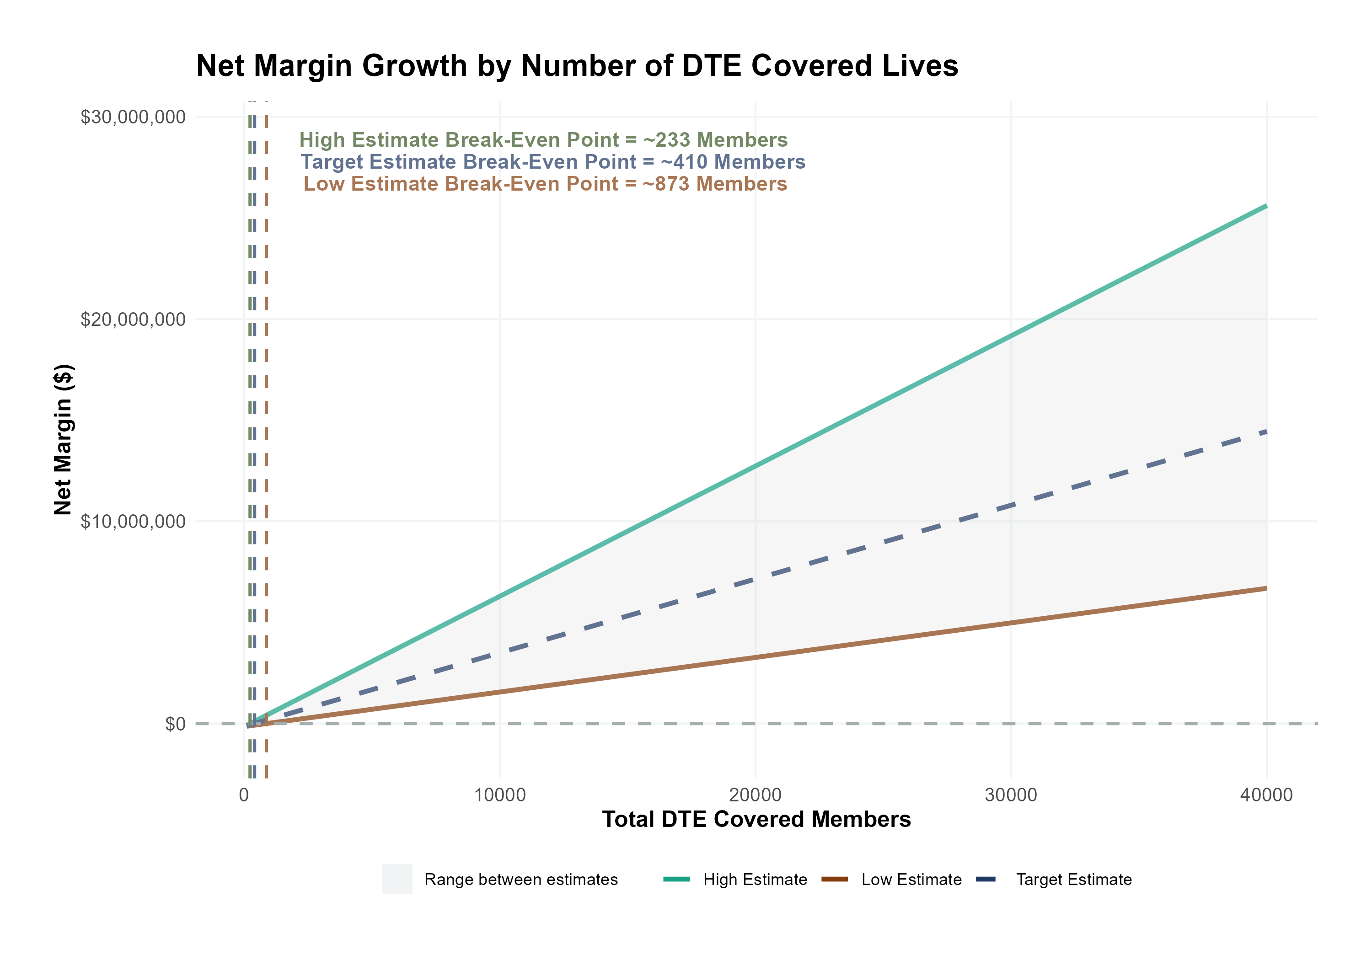
Estimated Financial Returns and Assumptions
Patient Steerage Assumptions
Net Margin Growth by Number of KIP Covered Lives
KBA currently estimates that Just Health has 21% inpatient market share, and 13% outpatient market compared to hospitals/clinics in Union, Essex and Hudson Counties. We expect within-KIP steerage to increase to (inpatient/outpatient):
SINGLE-YEAR PROJECTION
Low
Target
High
25%/15%
27.5%/17.5%
30%/22%
Commercial Margin Assumptions
KBA observes a Just Health 40.8 % commercial margin. We estimate that this margin will improve for patients covered by the KIP plan through higher collections as follows:
Low
Target
High
45.8%
50.8%
55.8%
Total KIP Covered Members

Slide 7
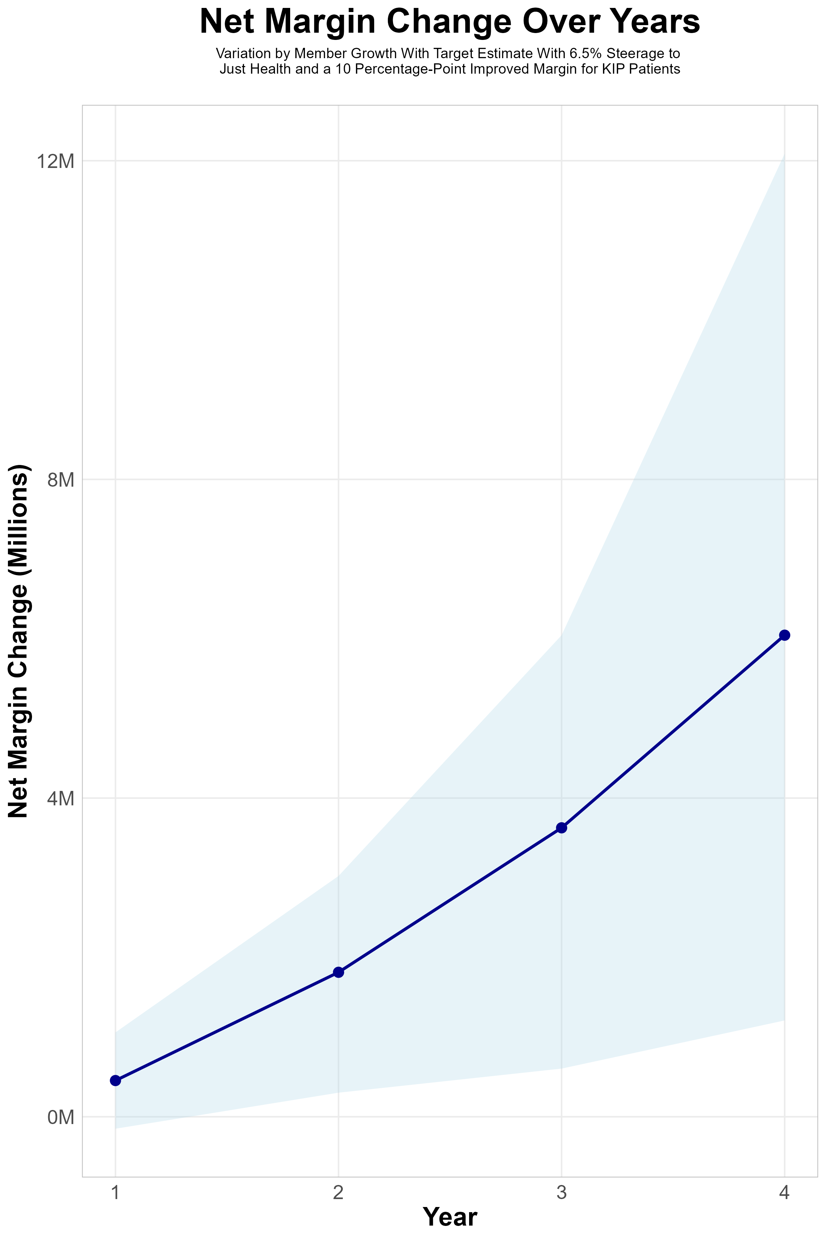
FOUR-YEAR PROJECTIONS
Target Member Growth | Target Member Growth | Target Member Growth | Target Member Growth | Target Member Growth
Metric | Year 1 | Year 2 | Year 3 | Year 4
Number of Members | 1,000 | 3,000 | 6,000 | 10,000
Incremental Margin | 592.5K | 1,777.4K | 3,554.7K | 5,924.5K
Network Access Fee | 12.0K | 36.0K | 72.0K | 120.0K
Implementation Fee (One-Time) | -150.0K | 0.0K | 0.0K | 0.0K
Net Margin Change | 454.5K | 1,813.4K | 3,626.7K | 6,044.5K
High Member Growth | High Member Growth | High Member Growth | High Member Growth | High Member Growth
Metric | Year 1 | Year 2 | Year 3 | Year 4
Number of Members | 2,000 | 5,000 | 10,000 | 20,000
Incremental Margin | 1,184.9K | 2,962.3K | 5,924.5K | 11,849.0K
Network Access Fee | 24.0K | 60.0K | 120.0K | 240.0K
Implementation Fee (One-Time) | -150.0K | 0.0K | 0.0K | 0.0K
Net Margin Change | 1,058.9K | 3,022.3K | 6,044.5K | 12,089.0K
Low Member Growth | Low Member Growth | Low Member Growth | Low Member Growth | Low Member Growth
Metric | Year 1 | Year 2 | Year 3 | Year 4
Number of Members | 0 | 500 | 1,000 | 2,000
Incremental Margin | 0.0K | 296.2K | 592.5K | 1,184.9K
Network Access Fee | 0.0K | 6.0K | 12.0K | 24.0K
Implementation Fee (One-Time) | -150.0K | 0.0K | 0.0K | 0.0K
Net Margin Change | -150.0K | 302.2K | 604.5K | 1,208.9K
Just Health will be responsible for sales and growth of this plan.
These growth numbers are for modeling only.

Slide 8
SINGLE YEAR SUMMARY
KIP Covered Members Financial Analysis | DTE Covered Members Financial Analysis | DTE Covered Members Financial Analysis | DTE Covered Members Financial Analysis | DTE Covered Members Financial Analysis | DTE Covered Members Financial Analysis | DTE Covered Members Financial Analysis | DTE Covered Members Financial Analysis
Target Estimate With 6.5% Steerage to Just Health and a 10 Percentage-Point Improved Margin for KIP Patients. | Target Estimate With 6.5% Steerage to Just Health and a 10 Percentage-Point Improved Margin for KIP Patients. | Target Estimate With 6.5% Steerage to Just Health and a 10 Percentage-Point Improved Margin for KIP Patients. | Target Estimate With 6.5% Steerage to Just Health and a 10 Percentage-Point Improved Margin for KIP Patients. | Target Estimate With 6.5% Steerage to Just Health and a 10 Percentage-Point Improved Margin for KIP Patients. | Target Estimate With 6.5% Steerage to Just Health and a 10 Percentage-Point Improved Margin for KIP Patients. | Target Estimate With 6.5% Steerage to Just Health and a 10 Percentage-Point Improved Margin for KIP Patients. | Target Estimate With 6.5% Steerage to Just Health and a 10 Percentage-Point Improved Margin for KIP Patients.
KIP Members | Pre-KIP Revenue | Pre-KIP Margin | KIP Revenue | KIP Incr. Revenue | KIP Total Margin | KIP Incr. Margin | Net Margin Less KIP Fees
100 | $ 216K | $ 88K | $ 288K | $ 72K | $ 146K | $ 58K | $ -91K
500 | $ 1,079K | $ 441K | $ 1,438K | $ 359K | $ 731K | $ 290K | $ 146K
1,000 | $ 2,158K | $ 881K | $ 2,876K | $ 717K | $ 1,462K | $ 580K | $ 442K
2,500 | $ 5,396K | $ 2,203K | $ 7,190K | $ 1,793K | $ 3,654K | $ 1,451K | $ 1,331K
10,000 | $21,585K | $ 8,812K | $28,758K | $ 7,174K | $14,617K | $ 5,805K | $ 5,775K
20,000 | $43,170K | $17,625K | $57,517K | $14,347K | $29,234K | $11,609K | $11,699K
NOTE: Please see detailed financial analysis and assumptions used starting on page 15.
Financial projections do not include 340B contribution margin, which could represent $136 PMPM by optimizing 340B through Rx plan design, JH’s approved site(s) with network integration, and development of JH’s proprietary PBM program.

Slide 9

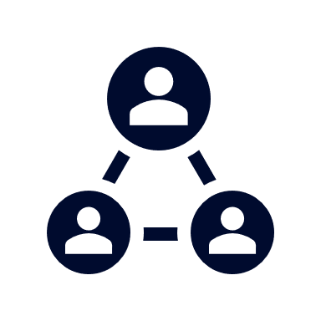



A Partner You Can Trust
OUR OBJECTIVES ARE ALIGNED
WE KNOW THE
MARKET
COMPLETELY TRANSPARENT
WE HAVE THE SOPHISTICATION AND INFRASTRUCTURE TO EFFECTIVELY COMPETE
Derek Moore, Senior Vice President – KBA
845-283-9973 * derek.moore@keybenefit.com

